Slide 1

Research Storage Simplified
John Reiland
RC Template Presentation
Presenter Name

Slide 2
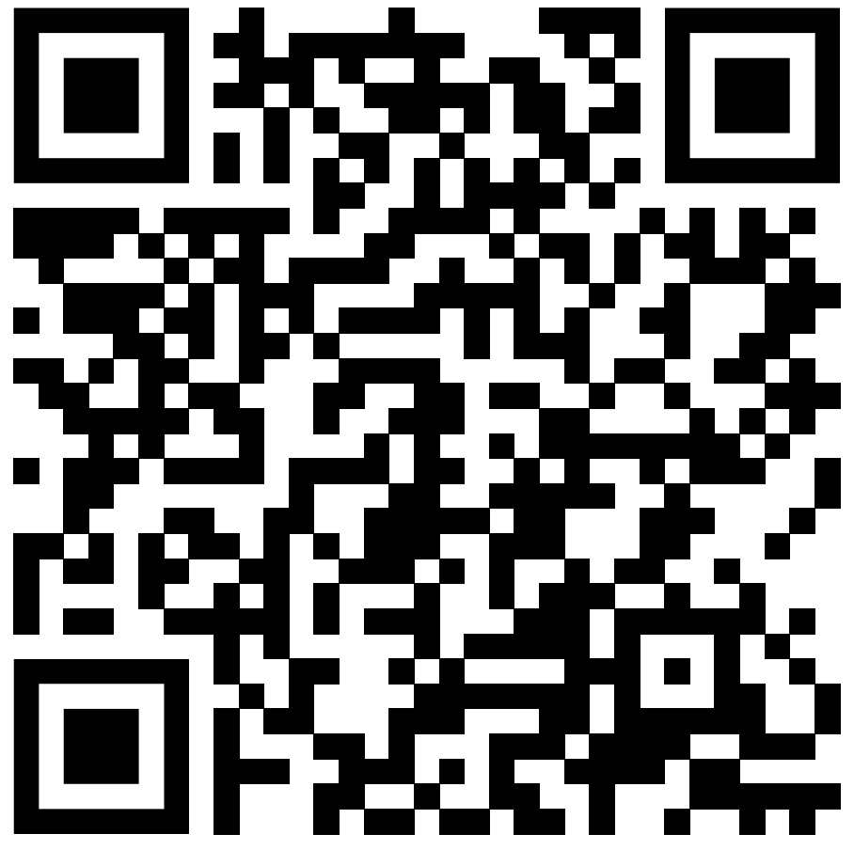
View the Slides [replace QR code and link!]
https://github.com/ResearchComputing/research_storage_simplified

Slide 3

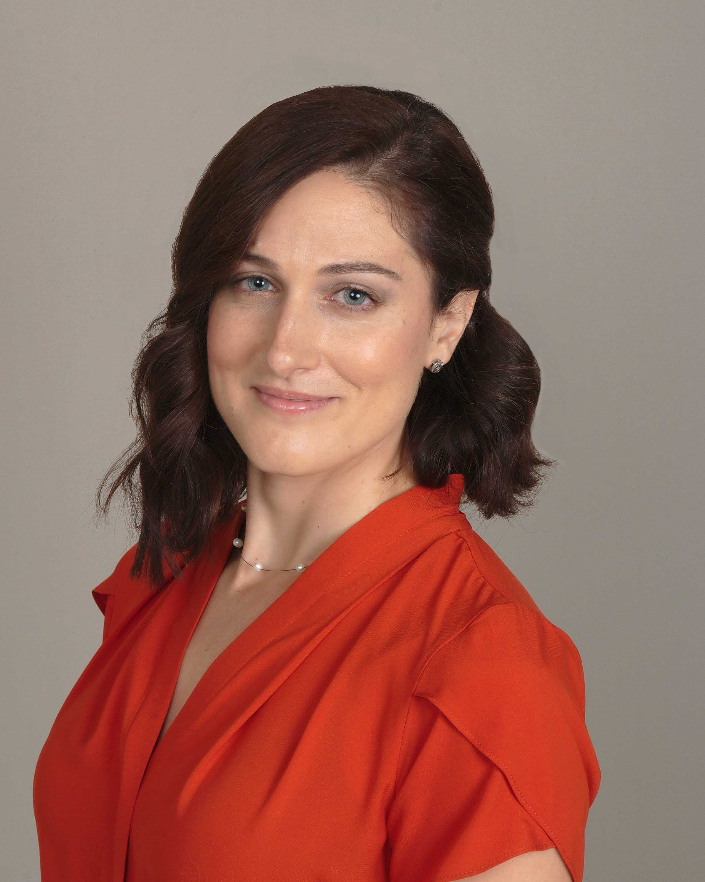
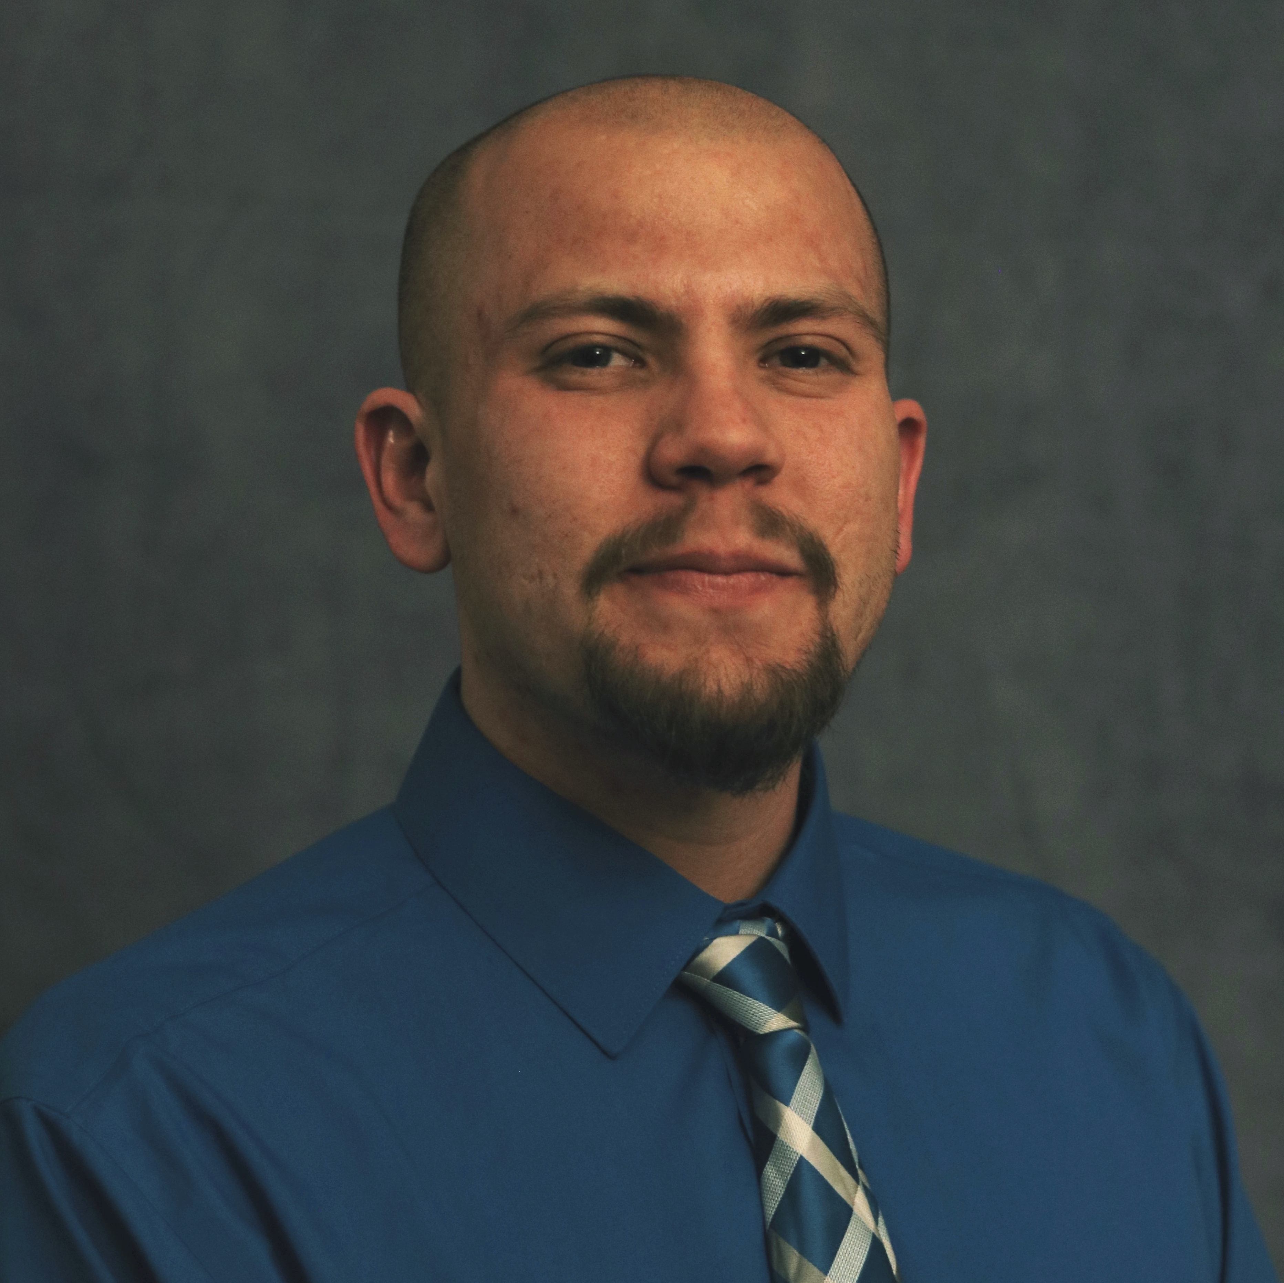
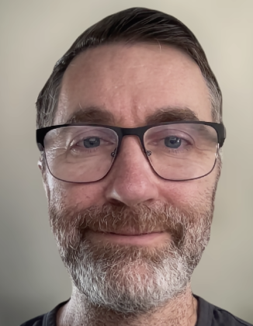


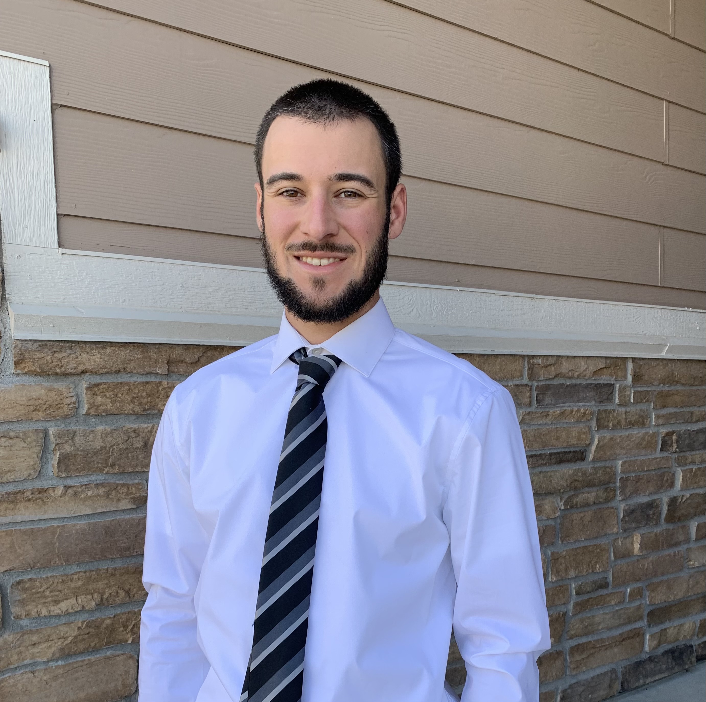


Meet the User Support Team
Layla Freeborn
Brandon Reyes
Andy Monaghan
Michael Schneider
John
Reiland
Dylan Gottlieb
Mohal Khandelwal
Ragan
Lee
3

Slide 4
Example Content
Important: This content should be readable to low-vision and blind users; visual elements (such as bolding, italics, color, etc.) should not be the sole method of demonstrating importance
Provide alternate, non-visual, means of emphasis, such as the use of key words (important, warning, attention, caution, note, etc.)
Use the “Inspect without Color” tool in the Review tab under Check Accessibility
Format bullet points as a “list” in PowerPoint; do not manually add dashes or asterisks to create lists.

Slide 5
Example Content 2
All slides should have a unique title
Don’t forget alt text descriptions for images, or to mark decorative items as such – Everything you need to know to write Alt Text
Text size should be at least 18
Ensure high contrast – Color Contrast Checker
Avoid tables
Remember to check reading order using the “Selection Pane” tool
Review Tab > “Check Accessibility” > “Selection Pane”
Additional guidelines and recommendations can be found in CU’s Digital Accessibility Office: PowerPoint Accessibility Guidelines
Microsoft Accessibility Guidelines for PowerPoint: Making Powerpoint Presentations Accessible

Slide 6


Another example (with alt text)
/home ← Private!!!
/projects
/scratch
PetaLibrary Space

Slide 7
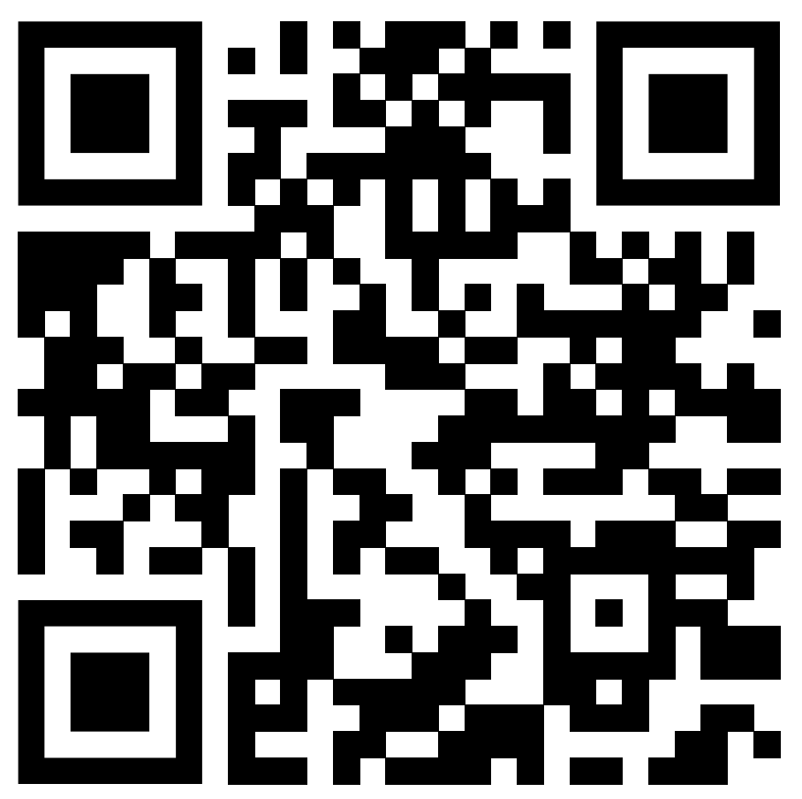
Documentation
https://curc.readthedocs.io/en/latest/

Slide 8
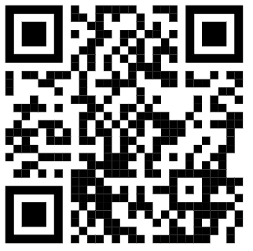
Survey and feedback
Survey: http://tinyurl.com/curc-survey18

